Slide 1
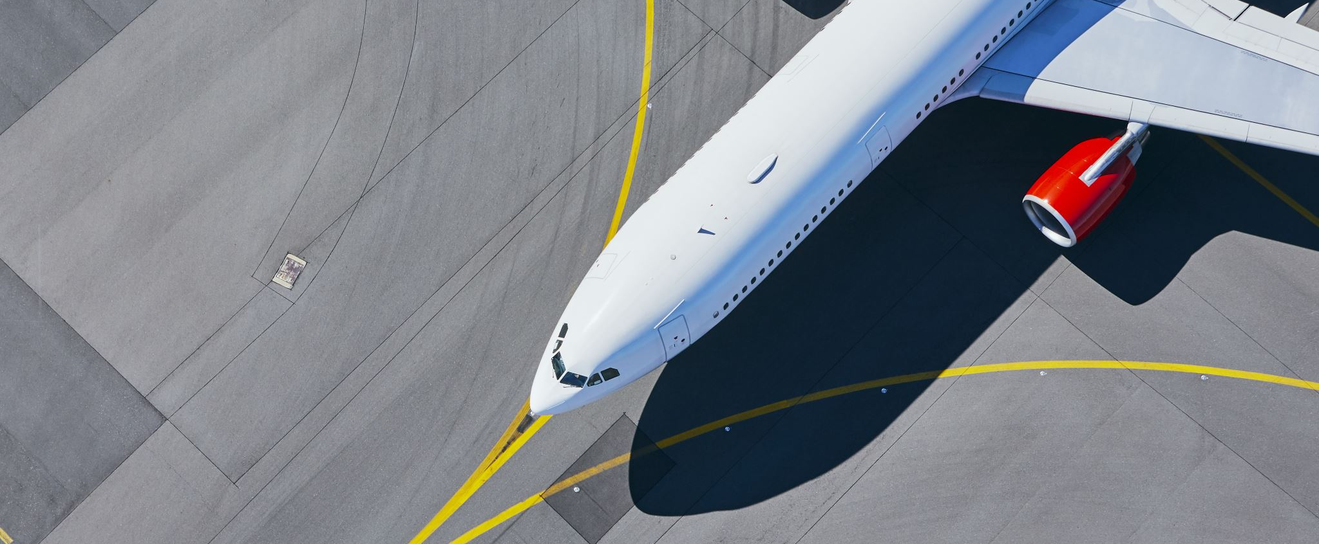
British Airways Customer Insight.

Slide 2
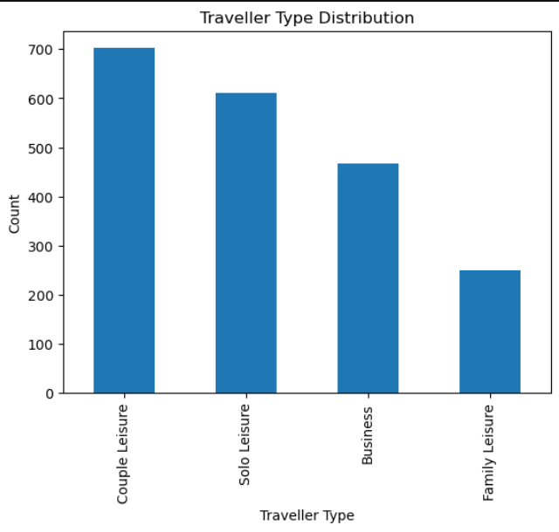
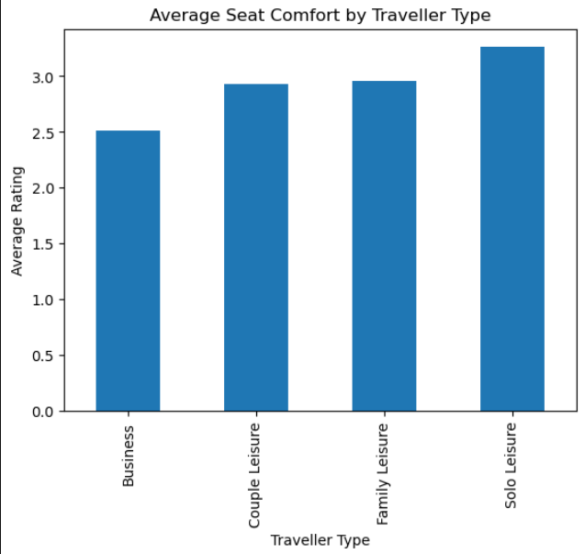
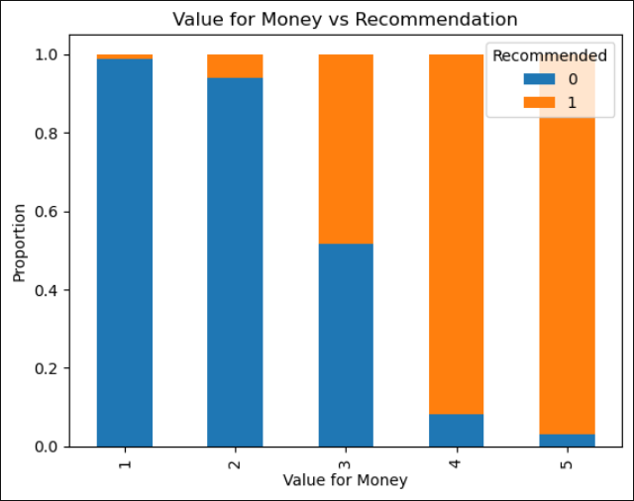
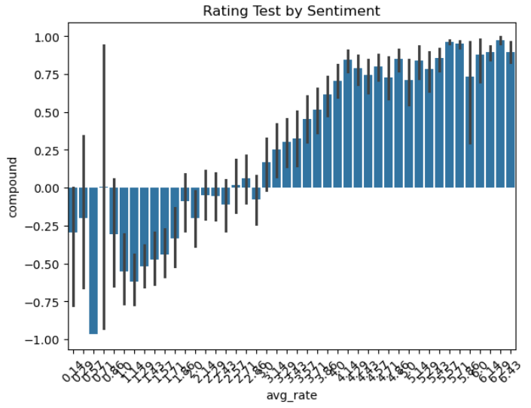
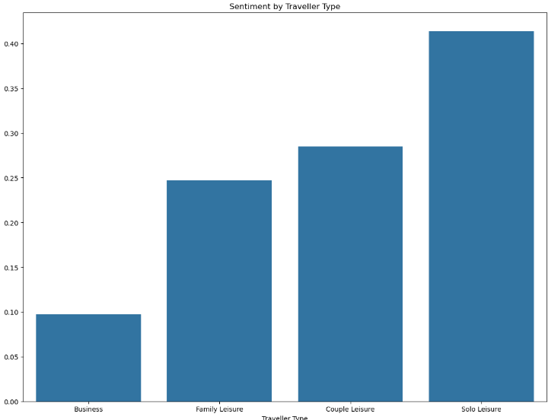
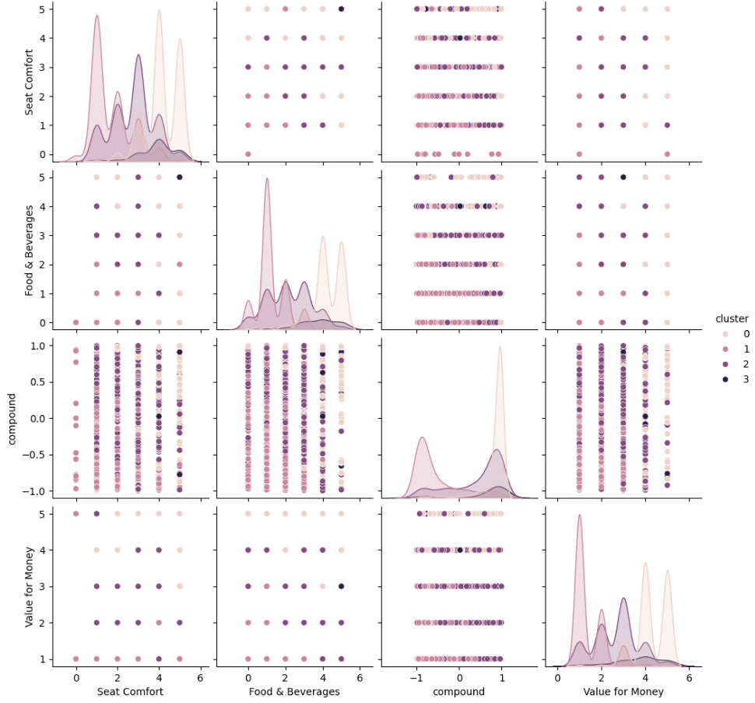
Customer Reviews
Total Number of Reviews : 2031
Most Frequent Travelling Type is Couple Leisure.
Most Comfortable Seat Rating is Solo Leisure.
A Strong Positive Co-relation between Recommendation and Value for money
Rating after 3.5 is less likely to be a negative review
The graph shows distinct customer clusters where positive sentiment correlates with high Value for Money and Seat Comfort, while negative sentiment aligns with lower ratings across features
Positive Sentiment reviews done by mostly Solo group and Business Class needs some actual Improvement .
Positive = 1317
Neutral = 3
Negative = 711

